Slide 1
Autonomous Intersection Management

Slide 2
Introduction about AIM and motivation
Idea: Autonomously and efficiently manage/schedule vehicles through a 4-way dedicated lane intersection.
Vehicle collisions at intersections account for anywhere between 25% and 45% of all collisions. – Kurt Dresnor
By keeping the number of messages and amount of information transmitted to a minimum, the system can afford to put more communication reliability measures in place. Furthermore, each vehicle, as an autonomous agent, may have privacy concerns which should be respected. Keeping the communication complexity low will also make the system more scalable.
Focusing less on Driver Agents and mostly on the arbiter/Intersection Manager
Assumptions:
Fully autonomous vehicles (Tesla Model S P100D)
5G telecommunication (minimal delay) no communication failure
Centralized architecture with a high resource powerful computer system placed at the intersection powering the Intersection Manager (IM)
No error
To accomplish this we intend to use ROS, and a visualization software.

Slide 3
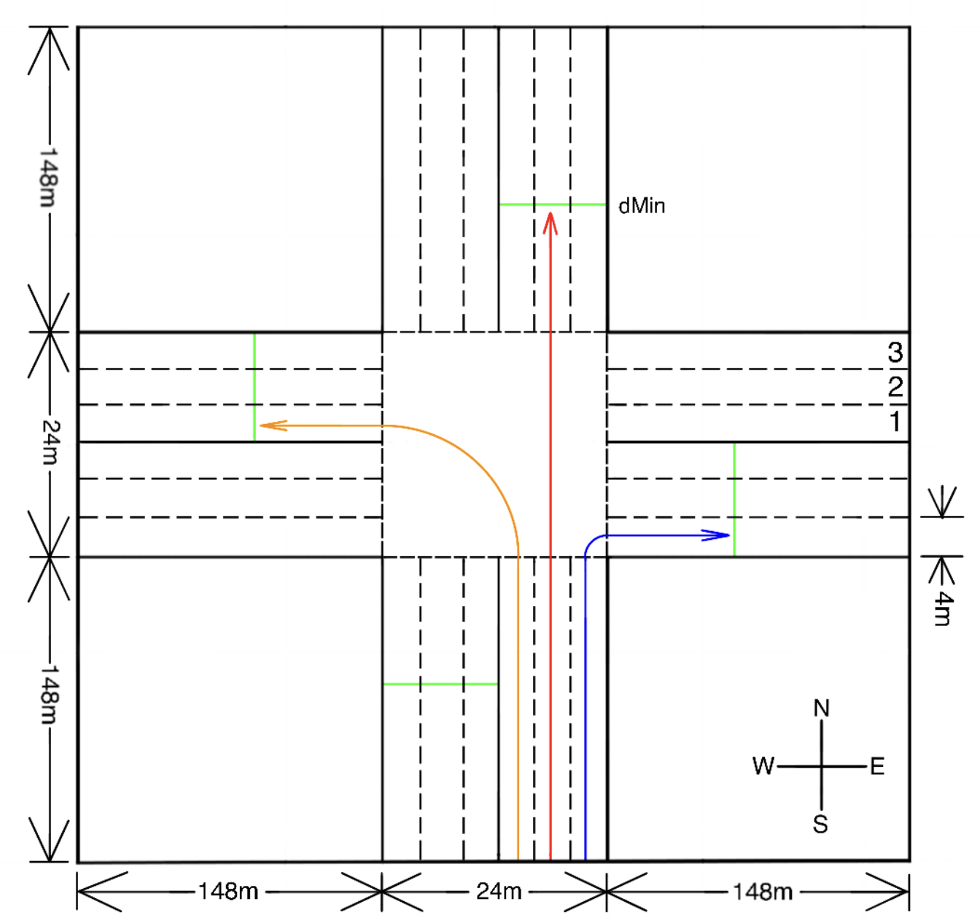

Slide 4
Previous Work
Worked on implementing an AIM System for a previous class
“A Multiagent Approach to Autonomous Intersection Management” by Kurt Dresner and Peter Stone
Reservation system using “First Come, First Served” policy
Use of a grid of “reservation” tiles
Dealing with acceleration in the intersection. Consider trajectories where the vehicle accelerates to max velocity, and maintains current velocity
Force a minimum velocity
Ability to change the policy

Slide 5
Project Scope & Implementation

Slide 6
Goals
Our system should:
Have no collisions
Decrease the average delay of vehicles passing through the intersection
Develop a policy for granting reservation requests to vehicles using trajectory planning
Compare our policy with other traffic control policies:
Traffic lights
Stop Signs
Dresner and Stone policy
Notes:
Cheaper Intersections???

